Slide 1
ANALYSING CHRONIC KIDNEY DISEASE USING VITAL PARAMTERES
Presentation by,
S.Saravanan,
Data Science Research Scholar

Slide 2
CHRONIC KIDNEY DISEASE
Chronic kidney disease includes conditions that damage your kidneys and decrease their ability to keep you healthy

Slide 3
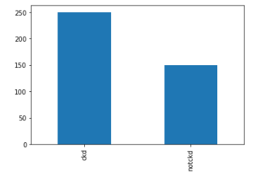
CHRONIC KIDNEY DISEASE(CKD)
More patients are having CKD

Slide 4
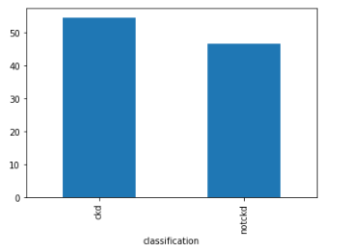
CKD Vs Age Group
It may affect any age group

Slide 5
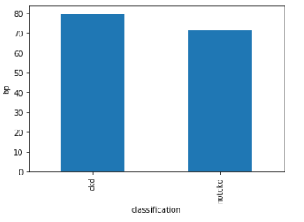
CKD Vs BP
CKD affects patients whose BP within the 80

Slide 6
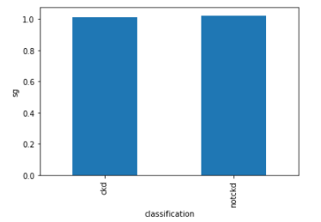
CKD vs Sg
Not a good feature

Slide 7
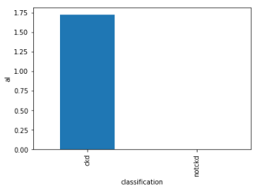
CKD vs Al
AL Amyloidosis
For higher Al, chance of getting CKD is higher

Slide 8
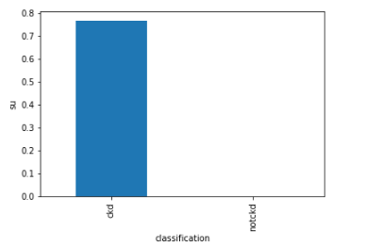
CKD vs su
Higher su higher is the chance of CKD

Slide 9
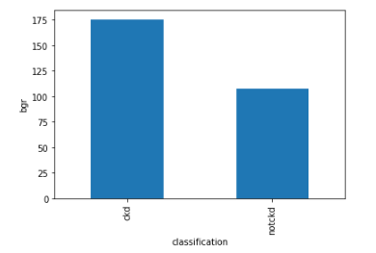
CKD vs bgr
Higher bgr higher is the chance for CKD

Slide 10
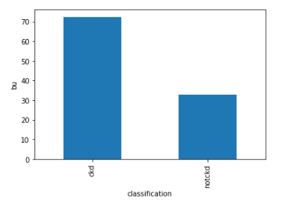
CKD vs Bu
Higher Bu higher is the chance of CKD

Slide 11
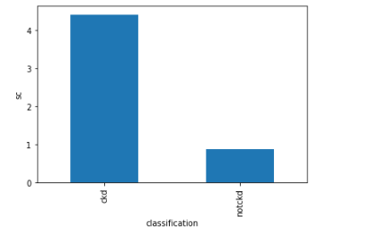
CKD vs Sc
Higher Sc ,higher is the chance of CKD

Slide 12
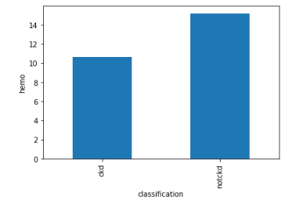
CKD vs Hemo
For higher Hemo, chance of CKD is less

Slide 13
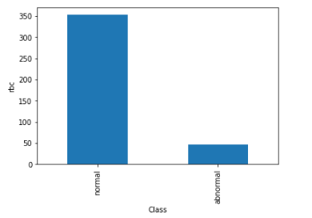
RBC value
Rbc value is normal for more patients

Slide 14
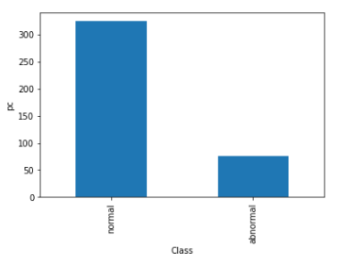
PC value
Pc value is normal for more patients

Slide 15
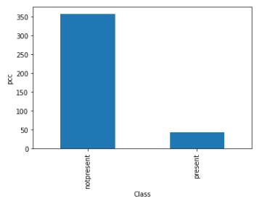
PCC Value
Pcc is not present in most patients

Slide 16
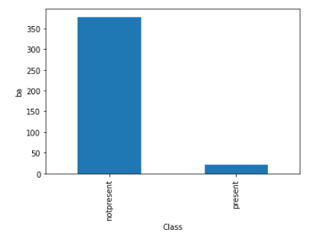
BA Value
Ba is not present in most patients

Slide 17
Model
Random Forest Model is used
Accuracy Score – 99%
Recall Value – 99%

Slide 18
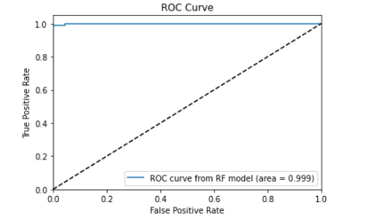
RoC Curve

Slide 19
Features of Importance
Sg
Sc
Pcv
Al
Sod

